Slide 1
WorkshopPLUS - Windows PowerShell: Foundation Skills
Notes:
Version: 02/08/2019 14:10:39

Slide 2
Disclaimer

Slide 3
From Script Blocks to Scripts

Slide 4
Learning Units covered in this Module
Using Script Blocks Providers Scripts

Slide 5
Using Script Blocks

Slide 6
After completing Using Script Blocks, you will be able to:
Work with script blocks
Work with functions
Work with remoting

Slide 7
What is a Script Block?

Slide 8
What is a Script Block?
A statement list in braces “{ }”
Simplifies reuse of code for commands with script block parameters
Can accept parameter values and return output
Used by Cmdlets, Functions, Workflows and Desired State Configuration

Slide 9
Script Block - Examples
{<statement list>}
{ param ($parameter1,$parameterN) <statement list> }
PS C:\> $scriptblock = { param($test) write-host $test} PS C:\> &$scriptblock "2" 2

Slide 10
Cmdlet with Script Block Parameter Argument
PS C:\> Invoke-Command -ScriptBlock {Get-Process} –ComputerName >> DC, MS, WIN10 Handles NPM(K) PM(K) WS(K) VM(M) CPU(s) Id ProcessName ------- ------ ----- ----- ----- ------ -- ----------- 4848 55 48316 64252 237 3,077.20 1840 CcmExec 76 8 1948 7180 60 3.55 9356 conhost 386 23 7768 18512 286 0.16 14092 csrss ...
PS C:\> Measure-Command -Expression {Get-Process} Days : 0 Minutes : 0 Seconds : 2 Milliseconds : 933 Ticks : 29332816 ...

Slide 11

Demonstration
Script Blocks

Slide 13
Functions Introduction

Slide 14
What is a Function?
Named Script Block
Reusable block of PowerShell code
Reduces size of code and increases reliability
Can accept parameter values and return output
Advanced Functions behave like Cmdlets
Can be created with help topics that can be used with Get-Help (like cmdlets)
Notes:
A function is a named block of code that performs an action. When you type the function name, the code in the function runs.
Functions can return objects and data as well as executing code. Functions can also take parameters as input.
Functions must be defined in the script before they are called.

Slide 15
What Does a Function Look Like?
Function Keyword
Function Name
Matching Open /Close Curly Braces
Statement List
Use Function
1
2
function Do-Something { Write-Host “Do Something” } Do-Something
3
4
3
5
Notes:
A function is a named block of code that performs an action. When you type the function name, the code in the function runs.
Functions can return objects and data as well as executing code. Functions can also take parameters as input.
Functions must be defined in the script before they are called.

Slide 16
Creating a Utility Function
A series of commands can be contained in a function
PS C:\> Get-Service -Name spooler -RequiredServices -ComputerName DC
function Get-ServiceInfo
{
Get-Service -Name spooler -RequiredServices -ComputerName DC
}
Run the function
PS C:\> Get-ServiceInfo
Notes:
Note the Tab for all lines between {} to create readability in your scripts

Slide 17
Parameters in a function
Defined using param statement
Used just like variables
Passed in using Dash notation
Can have advanced attributes
function Get-ServiceInfo
{
Param ($svc, $computer)
Get-Service -Name $svc -RequiredServices -ComputerName $computer
}
PS C:\> Get-ServiceInfo -svc spooler -computer localhost

Slide 18
Demonstration
Functions 101

Slide 20
Introduction to PowerShell Remoting

Slide 21
Various PowerShell Remote Administration Techniques
Entry Point
Transport
Network
Resource-Specific Cmdlets Native OS Remoting
DCOM
RPC
TCP/IP
WMI Cmdlets
CIM Cmdlets
WS-MAN
CIM Sessions
Connection Settings Only, Non-Stateful
CDXML Cmdlets
Featured in this Module
DSC Cmdlets
Workflows
PSSessions
Stateful Connection
Remoting Cmdlets
Notes:
There are 3 key areas of remoting in PowerShell 2. 0
The first type is using legacy remoting protocols built into the operating system such as RPC and DCOM.
This does not require an agent on the remote machine.
The second is WMI which has been installed by default on operating systems since Windows 2000 and again require no agent.
The third type is using the WS-MAN protocol introduced in Windows Server 2008 R2 and will be discussed in depth in this lesson.
PowerShell 3.0 adds CIM sessions. Technically these do not require PowerShell remoting to be enabled, but they run over WS-MAN.
http://www.powershellmagazine.com/2014/04/01/desired-state-configuration-and-the-remoting-myth/
PowerShell 3.0 adds Workflows, which use a specially-configured session configuration over PS remoting.
PowerShell 4.0 adds Desired State Configuration (DSC), which uses CIM sessions.

Slide 22
Native OS Remoting (-ComputerName Parameter)
Typically Windows resource or action specific cmdlets
Use built-in Windows services
Target machines do not need PowerShell remoting
Examples:
PS C:\> Get-Command -ParameterName ComputerName
...
Get-Counter; Get-EventLog; Get-HotFix; Restart-Computer; Get-Process; Get-Service; Stop-Computer; Test-Connection

Slide 23


What is PowerShell Remoting?
Introduced in Windows PowerShell 2.0 and enhanced in later versions
Windows PowerShell feature
Interactively run command(s) with a single remote computer
Run scriptblock or script on one or more remote computers
Temporary or Persistent Sessions (connections)
Destination can be restricted by limiting allowed commands and language elements
Temporary or Persistent Session(s)
PS C:\>
Interactive (1:1)
PS C:\>
Run Command(s) (1:Many)
PS C:\>

Slide 24
Requirements
Local and Remote Computers:
PowerShell 2.0 or later (feature enhancements with newer versions)
Remoting must be enabled:
Enabled by default on Windows Server 2012 Operating Systems (OS) and later
Disabled by default on all Client and earlier Server OS’s
Remote User Permissions:
Must be a member of the Local Administrator group on the remote computer(s) (by default)
Notes:
To run remote sessions on Windows PowerShell 2.0, the local and remote computers
must have the following:
-- Windows PowerShell 2.0 or later
-- The Microsoft .NET Framework 2.0 or later
-- Windows Remote Management 2.0
You can create remote sessions between computers running Windows PowerShell 2.0
and Windows PowerShell 3.0. However, features that run only on Windows
PowerShell 3.0, such as the ability to disconnect and reconnect to sessions, are
available only when both computers are running Windows PowerShell 3.0.
WINDOWS NETWORK LOCATIONS and Remoting
Beginning in Windows PowerShell 3.0, the Enable-PSRemoting cmdlet can enable
remoting on client and server versions of Windows on private, domain, and
public networks.
On server versions of Windows with private and domain networks, the
Enable-PSRemoting cmdlet creates firewall rules that allow unrestricted
remote access. It also creates a firewall rule for public networks that
allows remote access only from computers in the same local subnet. This
local subnet firewall rule is enabled by default on server versions of
Windows on public networks, but Enable-PSRemoting reapplies the rule in
case it was changed or deleted.
On client versions of Windows with private and domain networks, by
default, the Enable-PSRemoting cmdlet creates firewall rules that
allow unrestricted remote access.
To enable remoting on client versions of Windows with public networks,
use the SkipNetworkProfileCheck parameter of the Enable-PSRemoting cmdlet.
It creates a firewall rule that that allows remote access only from
computers in the same local subnet.
To remove the local subnet restriction on public networks and allow remote
access from all locations on client and server versions of Windows, use
the Set-NetFirewallRule cmdlet in the NetSecurity module. Run the following
command:
Set-NetFirewallRule -Name "WINRM-HTTP-In-TCP-PUBLIC" -RemoteAddress Any
RUN AS ADMINISTRATOR
Administrator privileges are required for the following remoting
operations:
-- Establishing a remote connection to the local computer. This is
commonly known as a "loopback" scenario.
-- Managing session configurations on the local computer.
-- Viewing and changing WS-Management settings on the local computer.
These are the settings in the LocalHost node of the WSMAN: drive.

Slide 25
Enabling Remoting
Use local command or Group Policy
Start PowerShell with the "Run as administrator“ option
PS C:\> Enable-PSRemoting
Use group policy for bulk configuration
Notes:
To run remote sessions on Windows PowerShell 2.0, the local and remote computers
must have the following:
-- Windows PowerShell 2.0 or later
-- The Microsoft .NET Framework 2.0 or later
-- Windows Remote Management 2.0
You can create remote sessions between computers running Windows PowerShell 2.0
and Windows PowerShell 3.0. However, features that run only on Windows
PowerShell 3.0, such as the ability to disconnect and reconnect to sessions, are
available only when both computers are running Windows PowerShell 3.0.
WINDOWS NETWORK LOCATIONS and Remoting
Beginning in Windows PowerShell 3.0, the Enable-PSRemoting cmdlet can enable
remoting on client and server versions of Windows on private, domain, and
public networks.
On server versions of Windows with private and domain networks, the
Enable-PSRemoting cmdlet creates firewall rules that allow unrestricted
remote access. It also creates a firewall rule for public networks that
allows remote access only from computers in the same local subnet. This
local subnet firewall rule is enabled by default on server versions of
Windows on public networks, but Enable-PSRemoting reapplies the rule in
case it was changed or deleted.
On client versions of Windows with private and domain networks, by
default, the Enable-PSRemoting cmdlet creates firewall rules that
allow unrestricted remote access.
To enable remoting on client versions of Windows with public networks,
use the SkipNetworkProfileCheck parameter of the Enable-PSRemoting cmdlet.
It creates a firewall rule that that allows remote access only from
computers in the same local subnet.
To remove the local subnet restriction on public networks and allow remote
access from all locations on client and server versions of Windows, use
the Set-NetFirewallRule cmdlet in the NetSecurity module. Run the following
command:
Set-NetFirewallRule -Name "WINRM-HTTP-In-TCP-PUBLIC" -RemoteAddress Any
RUN AS ADMINISTRATOR
Administrator privileges are required for the following remoting
operations:
-- Establishing a remote connection to the local computer. This is
commonly known as a "loopback" scenario.
-- Managing session configurations on the local computer.
-- Viewing and changing WS-Management settings on the local computer.
These are the settings in the LocalHost node of the WSMAN: drive.

Slide 26
Demonstration
PowerShell Native OS Remoting

Slide 28
Using PowerShell Remoting

Slide 29
Remoting Scenarios
PS C:\>
PS C:\>
1:1 Interactive with Temporary Session
Temporary session
Starting a session
Remote Computer
PS C:\> Enter-PSSession -ComputerName DC
[DC] PS C:\>
[DC] PS C:\> Hostname
DC
[DC] PS C:\> Exit-PSSession
PS C:\> Hostname
WIN10
Local Computer
Ending a session

Slide 30
Interactive Session
PS C:\> Enter-PSSession -ComputerName DC
[DC] PS C:\>
[DC] PS C:\> Hostname
DC
[DC] PS C:\> Exit-PSSession
PS C:\>
Remote Computer
Ending a session
Local Computer

Slide 31
Invoke a Command
PS C:\> Invoke-Command -ComputerName DC
>> -ScriptBlock {Get-Culture}
LCID Name DisplayName SComputerName
---- ---- ----------- --------------
1033 en-US English (United States) DC

Slide 32
Invoke a Command (1:Many)
PS C:\> Invoke-Command -ComputerName DC, MS
>> -ScriptBlock {Get-Culture}
LCID Name DisplayName PSComputerName
---- ---- ----------- --------------
1033 en-US English (United States) DC
1033 en-US English (United States) MS

Slide 33
Use Alternate Credential
PS C:\> Invoke-Command -ComputerName DC –Credential
>> contoso\administrator -ScriptBlock {Get-Culture}
LCID Name DisplayName PSComputerName
---- ---- ----------- --------------
1033 en-US English (United States) DC

Slide 34
Persistent Session (Repeat Use)
Step 1: Create a persistent session
PS C:\> New-PSSession -ComputerName DC –OutVariable ps Id Name ComputerName State ConfigurationName Availability -- ---- ------------ ----- ----------------- ------------ 1 Session1 DC Opened Microsoft.PowerShell Available
Step 2: Use the session
PS C:\> Invoke-Command –Session $ps -ScriptBlock {Get-Culture} LCID Name DisplayName PSComputerName ---- ---- ----------- -------------- 3081 en-AU English (Australia) DC

Slide 35
Persistent Session (Repeat Use) 1:Many
Step 1: Create persistent sessions
PS C:\> New-PSSession -ComputerName DC, MS –OutVariable ps Id Name ComputerName State ConfigurationName Availability -- ---- ------------ ----- ----------------- ------------ 1 Session1 DC Opened Microsoft.PowerShell Available 2 Session2 MS Opened Microsoft.PowerShell Available
Step 2: Use the sessions
PS C:\> Invoke-Command –Session $ps -ScriptBlock {Get-Culture} LCID Name DisplayName PSComputerName ---- ---- ----------- -------------- 1033 en-US English (United States) DC 1033 en-US English (United States) MS
Notes:
PowerShell sessions are limited to the configuration of the session. You can view these sessions via:
Get-PSSessionConfiguration
microsoft.powershell <- Default listener
microsoft.powershell.workflow <- Workflow listener

Slide 36
Demonstration
PowerShell Remoting

Slide 38
Using Script Blocks
Notes:
Link to lab:

Slide 39
Providers

Slide 40
After completing Providers, you will be able to:
Work with PSproviders and PSdrives

Slide 41
What are Providers?

Slide 42
What are PowerShell Providers?
Define the logic to access, navigate and edit a data store
Functionally resemble a file system hierarchy
Common interface to different data stores

Slide 43
Where to Get Providers
PowerShell ships with built-in providers
Providers can be imported via a module
Examples of well-known imported providers:
Active Directory
SQL Server

Slide 44
What is a Powershell Drive?
A specific entry-point to a data store surfaced by a provider
Allows any data store to be exposed like a file system, as if it were a mounted drive
Classic file system volume naming convention <Drive Name>:
Consistent drive interaction with common Cmdlets

Slide 45
Built-in Providers
Provider | Drive | Data Store
Alias | Alias: | Windows PowerShell aliases
Certificate | Cert: | x509 certificates for digital signatures
Environment | Env: | Windows environment variables
FileSystem | C:, D:, etc. | File system drives, directories, and files
Function | Function: | Windows PowerShell functions
Registry | HKLM:, HKCU: | Windows registry
Variable | Variable: | Windows PowerShell variables
WSMan | WSMan: | WS-Management configuration information

Slide 46
Demonstration
PowerShell Providers and Drives

Slide 48
Drive Cmdlets

Slide 49
PowerShell Drive Cmdlets
Drive cmdlets can be used to create and remove access points into datastores managed by PSproviders

Slide 50
Get-PSDrive
Returns drives in current session
PS C:\> Get-PSDrive Name Used (GB) Free (GB) Provider Root ---- --------- --------- -------- ---- Alias Alias C 206.81 16.00 FileSystem C:\ Cert Certificate \ Env Environment Function Function HKCU Registry HKEY_CURRENT_USER HKLM Registry HKEY_LOCAL_MACHINE ……

Slide 51
New-PSDrive Remove-PSDrive
Creates a user-defined drive
PS C:\> New-PSDrive -Name HKCR -PSProvider Registry -Root HKEY_CLASSES_ROOT
Creates a user-defined drive (use only single letter name with persist)
PS C:\> New-PSDrive -Name H -PSProvider FileSystem -Root \\MS\HomeShare -Persist -Credential (Get-Credential Contoso\DanPark)
Removes a PowerShell drive (user or built-in)
PS C:\> Remove-PSDrive -Name HKCR
Notes:
To disable the auto creation of PS drives when loading modules the following environment variable can be set:
$Env:ADPS_LoadDefaultDrive = 0

Slide 52
Demonstration
Creating PS Drives

Slide 54
Item Cmdlets

Slide 55
Item Cmdlets
Item cmdlets are used to read and manipulate path objects
Item cmdlets cannot be used to manipulate sub properties like registry keys
Notes:
To manipulate sub properties the itemproperty cmdlets should be used

Slide 56
Item Cmdlets
Name | Example
Get-Item | PS C:\> Get-Item c:\Windows
Get-ChildItem | PS C:\> Get-ChildItem -Path C:\Windows
Copy-Item | PS C:\> Copy-Item c:\Logs -Destination d:\Logs –Recurse
Move-Item | PS C:\> Move-Item HKLM:\software\A\* HKLM:\software
Clear-Item | PS C:\> Clear-Item HKLM:\Software\MyCompany –Confirm

Slide 57
Item Cmdlets
Name | Example
Remove-Item | PS C:\> Get-ChildItem * -Include *.mp3 -Recurse | Remove-Item
Set-Item | PS C:\> Set-Item -Path env:UserRole -Value Administrator
Invoke-Item | PS C:\> Invoke-Item “d:\Documents\Users.xls"
New-Item | PS C:\> New-Item -ItemType file -Path “d:\test.txt", "c:\Logs\test.log"
Rename-Item | PS C:\> Rename-Item HKLM:\Software\Company -NewName Marketing

Slide 59
ItemProperty Cmdlets

Slide 60
ItemProperty Cmdlets
Item property cmdlets can read and manipulate sub properties at a path object location

Slide 61
ItemProperty Cmdlets
Name | Example
Get-ItemProperty | PS C:\> Get-ItemProperty -Path HKLM:\SOFTWARE\Microsoft\PowerShell\1
Copy-ItemProperty | PS C:\> Copy-ItemProperty -Path MyApp -Destination HKLM:\Software\MyAppRev2 -Name MyProperty
Move-ItemProperty | PS C:\> Move-ItemProperty HKLM:\Software\MyCompany\MyApp -Name Version -Destination HKLM:\Software\MyCompany\NewApp
Clear-ItemProperty | PS C:\> Clear-ItemProperty -Path HKLM:\Software\MyCompany\MyApp -Name Options
Notes:
Registry values are considered item properties not items.

Slide 62
ItemProperty Cmdlets
Name | Example
Remove-ItemProperty | PS C:\> Remove-ItemProperty -Path HKLM:\Software\MyApp -Name MyProperty
Set-ItemProperty | PS C:\> Get-ChildItem weekly.log | Set-ItemProperty -Name IsReadOnly -Value $true
New-ItemProperty | PS C:\> Get-Item -Path HKLM:\Software\MyCompany | New-ItemProperty -Name NoOfLocations -Value 3
Rename-ItemProperty | PS C:\> Rename-ItemProperty -Path HKLM:\Software\MyApp -Name config -NewName oldconfig

Slide 63
Demonstration
Item and Itemproperty Cmdlets

Slide 65
Content Cmdlets

Slide 66
Content Cmdlets
Name | Example
Get-Content | PS C:\> Get-Content C:\Logs\Log060912.txt -TotalCount 50 PS C:\> Get-Content Env:\CommonProgramFiles PS C:\> Get-Content Function:\Get-IseSnippet
Add-Content | PS C:\> Get-Content test.xml | Add-Content final.xml -Force -Encoding UTF8
Clear-Content | PS C:\> Clear-Content C:\Windows\Logs\bpa\Reports\* -Include 2013* -Exclude 2014*
Set-Content | PS C:\> Get-Date | Set-Content C:\Output\date.csv

Slide 67
Demonstration
Content Cmdlets

Slide 68
Path Cmdlets

Slide 69
Path Cmdlets
Path cmdlets can be used to manipulate path objects
Path commands understand how a path object is buildup

Slide 70
Path Cmdlets
Name | Example
Test-Path | PS C:\> Test-Path $pshome\PowerShell.exe -NewerThan "June 13, 2018“ True
Join-Path | PS C:\> Join-Path -Path C: -ChildPath Temp –Resolve C:\Temp
Split-Path | PS C:\> Split-Path -Path 'C:\Program Files (x86)\Internet Explorer\iexplore.exe' –Leaf iexplore.exe
Notes:
Join-path is useful for removing unwanted “\” in a file path. However it will only remove 1 instance when more than one “\” to much is encountered.

Slide 71
Path Cmdlets
Name | Example
Convert-Path | PS C:\> Convert-Path HKLM:\software\Microsoft HKEY_LOCAL_MACHINE\Software\Microsoft
Resolve-Path | PS C:\> Resolve-Path c:\prog* -Relative .\C:\Program Files .\C:\Program Files (x86)

Slide 72
Location Cmdlets
Name | Example
Get-Location | PS C:\> Get-Location C:\
Set-Location | PS C:\> Set-Location -Path HKLM:\SOFTWARE PS HKLM:\SOFTWARE>

Slide 73
Variable Syntax – Access PSDrive Items
Drive | Examples:
Alias: | PS C:\> $alias:dir Get-ChildItem
Env: | PS C:\> $Env:windir C:\windows
Function: | PS C:\> $function:more param([string[]]$paths) {…}
Variable: | PS C:\> $variable:ref localhost server1

Slide 74
Demonstration
Path Cmdlets

Slide 76
Providers
Notes:
Link to lab:

Slide 77
Scripts

Slide 78
After completing Scripts, you will be able to:
Understand how security policys prevent running scripts
Understand how to create commenting in scripts and synopsis

Slide 79
What is a Script?

Slide 80
What is a Script?
Reusable code
Text file (.ps1) containing one or more PowerShell commands
Simple ‘code packaging’ for distribution purposes
Can also:
Be digitally signed for security
Take parameter values
Return values
Use the help syntax

Slide 81
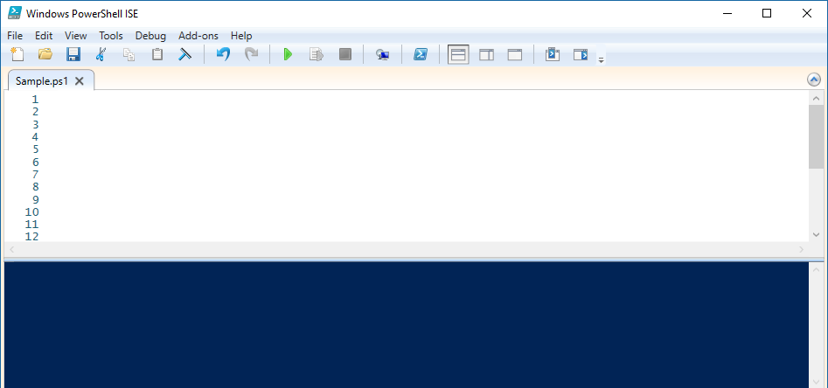
Simple Script Example
Write-Host "Start of script" -ForegroundColor White -BackgroundColor Green
Write-Host "Display the % CPU Time utilization by the ISE" -ForegroundColor White -BackgroundColor Green
Get-Counter "\Process(powershell_ise)\% Processor Time"
PS C:\scripts> C:\scripts\Sample.ps1
Start of script
Display the % CPU Time utilization by the ISE
Timestamp CounterSamples
--------- --------------
6/25/2018 11:22:39 AM \\WIN10\process(powershell_ise)\% processor time :
14.0038797593275

Slide 82
Demonstration
PowerShell Scripts

Slide 83
Execution Policies

Slide 84
Execution Policy Levels
Restricted
AllSigned
RemoteSigned
Unrestricted
Default in 2008R2 and below.
Scripts cannot be run
PowerShell interactive-mode only
Runs a script only if signed
Signature must be trusted on local machine
Default in 2012R2 and Beyond. (Recommended Minimum)
Runs all local scripts
Downloaded scripts must be signed by trusted source
All scripts from all sources can be run without signing
Notes:
Security Convenience not actual security…-ExecutionPolicy Bypass
https://blog.netspi.com/15-ways-to-bypass-the-powershell-execution-policy/

Slide 85
Execution Policy Scope
AD Group Policy – Computer
AD Group Policy – User
Process
Registry – Computer
Affects current PowerShell Host session only
Lost upon exit of session (i.e. host process)
Console or ISE Command-line Parameter (c:\> powershell.exe –executionpolicy remotesigned)
Affects all users on computer
Stored in HKLM registry subkey (Admin access needed to change)
Registry – User
Affects current user only
Stored in HKCU registry subkey
Affects all users on targeted computer
Edited through GPO Tools
Edited through GPO Tools
Affects users targeted only
Highest Priority Wins
Notes:
The Policy settings are located at:
Policies\Administrative Templates\Windows Components\Windows PowerShell

Slide 86
Script Execution
Default Execution Policy (Remote Signed) prevents any scripts from running
Must be changed to run any scripts
Execution Policy is saved in the registry, and therefore only needs to be changed once per computer

Slide 87
Determine Execution Policy in Effect
PS C:\> Get-ExecutionPolicy

Slide 88
Determine Which Execution Policy is in Effect
PS C:\> Get-ExecutionPolicy –List
Scope ExecutionPolicy
----- ---------------
MachinePolicy Undefined
UserPolicy Undefined
Process Undefined
CurrentUser Undefined
LocalMachine RemoteSigned
Top most takes precedence
Effective Policy

Slide 89
Set Execution Policy - User
Set-ExecutionPolicy -Scope CurrentUser -ExecutionPolicy Unrestricted
Apply setting to current user only, default is current machine
Notes:
The Set-ExecutionPolicy cmdlets can be used to set the execution policy, but PowerShell must be elevated to an administrator context to do this.
This setting is stored in the following registry key: HKEY_LOCAL_MACHINE\SOFTWARE\Microsoft\PowerShell\1\ShellIds\Microsoft.PowerShell.
To change the execution policy for the default (Local machine) scope. Launch PowerShell as an Administrator (Elevated).
This setting can also be controlled using the “Turn On Script Execution” policy in Group Policy Management.
This is installed by default in Windows 2008 R2, but can be downloaded as a custom ADM for Windows 2003 at the following link:
http://www.microsoft.com/downloads/details.aspx?FamilyID=2917a564-dbbc-4da7-82c8-fe08b3ef4e6d&DisplayLang=en

Slide 90
Demonstration
Execution Policy

Slide 92
Launching a script

Slide 93
Running a Script From the Shell
Full path and file name
PS C:\> c:\scripts\script.ps1
Script in current directory
PS C:\Scripts> .\script.ps1
Spaces in path (tab completion helps)
PS C:\> & "c:\scripts\my script.ps1"
Script is in environment path
PS C:\> Script.ps1
Notes:
The file extension for PowerShell script files is .ps1 for both PowerShell v1, v2, v3 and v4
To help stop scripts being accidentally run (with potentially devastating results), ps1 files cannot be executed by double clicking them in Windows Explorer; they are associated with notepad.
When running scripts directly from the PowerShell console, even when in the same directory as the script you must prefix the script name with “.\”.
This means execute the script in the current working directory. For example: .\myscript.ps1

Slide 94
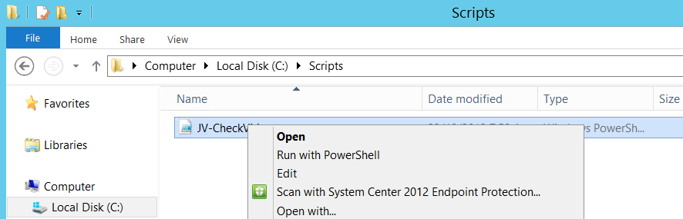
Running a Script With the Mouse
Script files cannot be double clicked to run
Run with PowerShell option:
Right-click script
Select Run with PowerShell
Notes:
The file extension for PowerShell script files is .ps1 for all versions of PowerShell
To help stop scripts being accidentally run (with potentially devastating results), ps1 files cannot be executed by double clicking them in Windows Explorer; they are associated with notepad.
When running scripts directly from the PowerShell console, even when in the same directory as the script you must prefix the script name with “.\”.
This means execute the script in the current working directory. For example: .\myscript.ps1

Slide 95
Launching a Script From Outside PowerShell (cmd.exe)
Optionally Keeps PowerShell Window open
Must be last parameter in command
C:\> Powershell.exe -NoExit -File "c:\scripts\isecputime.ps1"
Windows PowerShell
Copyright (C) Microsoft Corporation. All rights reserved.
Start of script
Display the % CPU Time utilization by the ISE
Timestamp CounterSamples
--------- --------------
6/25/2018 11:37:09 AM \\win10\process(powershell_ise)\% processor time :
0
Notes:
To run PowerShell scripts from scheduled tasks, a run command, or from a shortcut PowerShell.exe must be called and the script name passed in with the –file parameter.
powershell.exe –file “c:\myscript.ps1”
Other parameters that can be used when calling PowerShell can be found by typing the following:
PowerShell /?
Note: Bypass does not work if execution policy was set using GPO.
This still works: powershell -exec bypass -file c:\temp\test.ps1
This doesn't work: powershell -exec bypass -file \\localhost\c$\temp\test.ps1

Slide 96
Demonstration
Starting Scripts

Slide 98
Script signing

Slide 99
Script Signing
Script signing validates the integrity of the script between signing and execution
Execution policies can be used to enforce only signed scripts
Certificate used should be of type: Code signing
Public certificate should be used if script will be published

Slide 100
Script Signing
Code signing certificate
Trusted by computer where script will run
Step 1: Create a certificate variable
PS C:\> $cert = Get-ChildItem Cert:\CurrentUser\my\A4... >> -CodeSigningCert
Step 2: Sign script
PS C:\> Set-AuthenticodeSignature .\ISECPUTime.ps1 $cert Directory: C:\Scripts SignerCertificate Status Path ----------------- ------ ---- A4.. Valid ISECPUTime.ps1
Notes:
Setting the Execution Policy to All Signed means that only scripts that have been signed by a trusted certificate will run. Any scripts that are not signed will NOT be run.
To sign a script create a variable that holds a certificate with a code signing attribute. PKI and certificates themselves are outside the scope of this course. Once the certificate is installed on the local machine, it could be assigned to a variable with code similar to this:
$cert = Dir cert: -codesign –recurse
You can then use the Set-AuthenticodeSignature cmdlet to sign the script using similar syntax to this:
Set-AuthenticodeSignature .\test.ps1 $cert
This adds a hash to the end of the script file. This hash is made up from the code in the script and the certificate. Therefore if the code in the script is modified the script will no longer run, and must be resigned.
__________________
To sign scripts, you will need a specific kind of certificate—a Class III Authenticode Code-Signing Certificate—and there are three main ways to get one. The first is to use your organization's internal Public Key Infrastructure, or PKI, if it has one. A well-implemented PKI will have its root CA trusted by all of your organization's computers—this is necessary for the certificates issued by the CA to be usable in the organization.
Windows Server® has shipped with its own Certificate Server software since Windows® 2000, and you can use that software to create your own PKI. A full-fledged PKI implementation requires a lot of planning, but if you just need a PKI for the sole purpose of issuing code-signing certificates, you don't need to do a ton of work. You can simply use Group Policy to push your CA's root certificate out to your computers so that they'll trust it.
A second option is to use a commercial CA. One benefit of using a commercial CA is that, if you select one of the major CAs, your organization's computers are probably already configured to trust certificates from that CA. (Note that Windows XP trusts a large number by default, while Windows Vista® trusts a far smaller number by default). One popular commercial CA is VeriSign (verisign.com). There are others worth investigating, also, such as CyberTrust (cybertrust.com) and Thawte (thawte.com).
The third option for obtaining a code-signing certificate is to make your own self-signed certificate using a tool like Makecert.exe. It ships with the Windows Platform SDK, it installs in some editions of Microsoft® Office, and it can be found in many other places. The upside of a self-signed certificate is that it's free and doesn't require any infrastructure. The downside, however, is that it's really only usable on your computer. But if you just need to enable script execution on your computer—for testing or general experimentation with code signing—Makecert.exe is a great option. Documentation about this tool is at go.microsoft.com/fwlink/?LinkId=108538. Just be aware that many versions of this tool have existed over the years, so it's possible that your computer is running an older version that doesn't work exactly as the documentation describes.
Once you have Makecert.exe, you can then create a self-signed certificate by running something like the following from the Windows PowerShell command line (and don't let me catch anyone using cmd.exe when you're reading this column):
____________________
makecert -n "CN=MyRoot" -a sha1 –eku 1.3.6.1.5.5.7.3.3 -r -sv root.pvk root.cer –ss Root -sr localMachine
____________________
makecert -pe -n "CN=MyCertificate" -ss MY –a sh1 -eku 1.3.6.1.5.5.7.3.3 -iv root.pvk –c root.cer
____________________
gci cert:\CurrentUser\My –codesigning
____________________
$cert = @(gci cert:\currentuser\my -codesigning)[0]
Set-AuthenticodeSignature myscript.ps1 $cert
____________________
Code signing is the best step you can take, and it doesn't take much involvement. For example, I use a graphical script editor that automatically signs my scripts every time I press Save, so code signing is pretty much transparent for me.
You can make it more transparent even without a fancy editor. For example, you can create a Windows PowerShell profile for yourself (create the file Microsoft.PowerShell_profile.ps1 in a folder named WindowsPowerShell, located under your documents folder), and add this function to it:
function sign ($filename) {
$cert = @(gci cert:\currentuser\my
-codesigning)[0]
Set-AuthenticodeSignature $filename $cert
}
Now you can sign your script by simply entering:
Sign c:\scripts\myscript.ps1

Slide 101
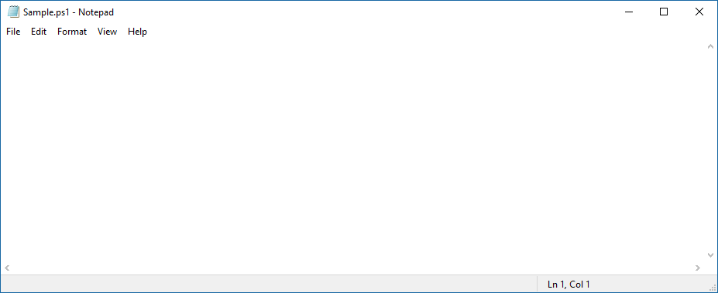
Script Before Signing
Write-Host "Start of script" -ForegroundColor White -BackgroundColor Green
Write-Host "Display the % CPU Time utilization by the ISE" -ForegroundColor White -BackgroundColor Green
Get-Counter "\Process(powershell_ise)\% Processor Time“
Notes:
Setting the Execution Policy to All Signed means that only scripts that have been signed by a trusted certificate will run. Any scripts that are not signed will NOT be run.
To sign a script create a variable that holds a certificate with a code signing attribute. PKI and certificates themselves are outside the scope of this course. Once the certificate is installed on the local machine, it could be assigned to a variable with code similar to this:
$cert = Dir cert: -codesign –recurse
You can then use the Set-AuthenticodeSignature cmdletto sign the script using similar syntax to this:
Set-AuthenticodeSignature .\test.ps1 $cert
This adds a hash to the end of the script file. This hash is made up from the code in the script and the certificate. Therefore if the code in the script is modified the script will no longer run, and must be resigned.
__________________
To sign scripts, you will need a specific kind of certificate—a Class III Authenticode Code-Signing Certificate—and there are three main ways to get one. The first is to use your organization's internal Public Key Infrastructure, or PKI, if it has one. A well-implemented PKI will have its root CA trusted by all of your organization's computers—this is necessary for the certificates issued by the CA to be usable in the organization.
Windows Server® has shipped with its own Certificate Server software since Windows® 2000, and you can use that software to create your own PKI. A full-fledged PKI implementation requires a lot of planning, but if you just need a PKI for the sole purpose of issuing code-signing certificates, you don't need to do a ton of work. You can simply use Group Policy to push your CA's root certificate out to your computers so that they'll trust it.
A second option is to use a commercial CA. One benefit of using a commercial CA is that, if you select one of the major CAs, your organization's computers are probably already configured to trust certificates from that CA. (Note that Windows XP trusts a large number by default, while Windows Vista® trusts a far smaller number by default). One popular commercial CA is VeriSign (verisign.com). There are others worth investigating, also, such as CyberTrust (cybertrust.com) and Thawte (thawte.com).
The third option for obtaining a code-signing certificate is to make your own self-signed certificate using a tool like Makecert.exe. It ships with the Windows Platform SDK, it installs in some editions of Microsoft® Office, and it can be found in many other places. The upside of a self-signed certificate is that it's free and doesn't require any infrastructure. The downside, however, is that it's really only usable on your computer. But if you just need to enable script execution on your computer—for testing or general experimentation with code signing—Makecert.exe is a great option. Documentation about this tool is at go.microsoft.com/fwlink/?LinkId=108538. Just be aware that many versions of this tool have existed over the years, so it's possible that your computer is running an older version that doesn't work exactly as the documentation describes.
Once you have Makecert.exe, you can then create a self-signed certificate by running something like the following from the Windows PowerShell command line (and don't let me catch anyone using cmd.exe when you're reading this column):
____________________
makecert -n "CN=MyRoot" -a sha1 –eku 1.3.6.1.5.5.7.3.3 -r -sv root.pvk root.cer –ss Root -sr localMachine
____________________
makecert -pe -n "CN=MyCertificate" -ss MY –a sh1 -eku 1.3.6.1.5.5.7.3.3 -iv root.pvk –c root.cer
____________________
gci cert:\CurrentUser\My –codesigning
____________________
$cert = @(gci cert:\currentuser\my -codesigning)[0]
Set-AuthenticodeSignature myscript.ps1 $cert
____________________
Code signing is the best step you can take, and it doesn't take much involvement. For example, I use a graphical script editor that automatically signs my scripts every time I press Save, so code signing is pretty much transparent for me.
You can make it more transparent even without a fancy editor. For example, you can create a Windows PowerShell profile for yourself (create the file Microsoft.PowerShell_profile.ps1 in a folder named WindowsPowerShell, located under your documents folder), and add this function to it:
function sign ($filename) {
$cert = @(gci cert:\currentuser\my
-codesigning)[0]
Set-AuthenticodeSignature $filename $cert
}
Now you can sign your script by simply entering:
Sign c:\scripts\myscript.ps1

Slide 102
Script Before Signing
Write-Host "Start of script" -ForegroundColor White -BackgroundColor Green
Write-Host "Display the % CPU Time utilization by the ISE" -ForegroundColor White -BackgroundColor Green
Get-Counter "\Process(powershell_ise)\% Processor Time“
# SIG # Begin signature block
# mIIEMwYJKoZIhvcNAQcCoIIEJDCCBCACAQExCzAJBgUrDgMCGgUAMGkGCisGAQQB
# kjcCAQSgWsBZMDQGCisGAQQBgjcCAR4wJgIDAQAABBAfzDtgWUsITrck0sYpfvNR
# agEAAsEAAgEAAgEAAgEAMCEwCQYFKw4DAhoFAAQU6vQAn5sf2qIxQqwWUDwTZnJj
# j5ufgfI9MIICOTCCAaagAwIBAgIQyLeyGZcGA4ZOGqK7VF45GDAJBgUrDgMCHQUA
# agEAAsEAAgEAAgEAAgEAMCEwCQYFKw4DAhoFAAQU6vQAn5sf2qIxQqwWUDwTZnJj
# kjcCAQSgWsBZMDQGCisGAQQBgjcCAR4wJgIDAQAABBAfzDtgWUsITrck0sYpfvNR
# SIG # End signature block
Script signature block
Notes:
Setting the Execution Policy to All Signed means that only scripts that have been signed by a trusted certificate will run. Any scripts that are not signed will NOT be run.
To sign a script create a variable that holds a certificate with a code signing attribute. PKI and certificates themselves are outside the scope of this course. Once the certificate is installed on the local machine, it could be assigned to a variable with code similar to this:
$cert = Dir cert: -codesign –recurse
You can then use the Set-AuthenticodeSignature cmdletto sign the script using similar syntax to this:
Set-AuthenticodeSignature .\test.ps1 $cert
This adds a hash to the end of the script file. This hash is made up from the code in the script and the certificate. Therefore if the code in the script is modified the script will no longer run, and must be resigned.
__________________
To sign scripts, you will need a specific kind of certificate—a Class III Authenticode Code-Signing Certificate—and there are three main ways to get one. The first is to use your organization's internal Public Key Infrastructure, or PKI, if it has one. A well-implemented PKI will have its root CA trusted by all of your organization's computers—this is necessary for the certificates issued by the CA to be usable in the organization.
Windows Server® has shipped with its own Certificate Server software since Windows® 2000, and you can use that software to create your own PKI. A full-fledged PKI implementation requires a lot of planning, but if you just need a PKI for the sole purpose of issuing code-signing certificates, you don't need to do a ton of work. You can simply use Group Policy to push your CA's root certificate out to your computers so that they'll trust it.
A second option is to use a commercial CA. One benefit of using a commercial CA is that, if you select one of the major CAs, your organization's computers are probably already configured to trust certificates from that CA. (Note that Windows XP trusts a large number by default, while Windows Vista® trusts a far smaller number by default). One popular commercial CA is VeriSign (verisign.com). There are others worth investigating, also, such as CyberTrust (cybertrust.com) and Thawte (thawte.com).
The third option for obtaining a code-signing certificate is to make your own self-signed certificate using a tool like Makecert.exe. It ships with the Windows Platform SDK, it installs in some editions of Microsoft® Office, and it can be found in many other places. The upside of a self-signed certificate is that it's free and doesn't require any infrastructure. The downside, however, is that it's really only usable on your computer. But if you just need to enable script execution on your computer—for testing or general experimentation with code signing—Makecert.exe is a great option. Documentation about this tool is at go.microsoft.com/fwlink/?LinkId=108538. Just be aware that many versions of this tool have existed over the years, so it's possible that your computer is running an older version that doesn't work exactly as the documentation describes.
Once you have Makecert.exe, you can then create a self-signed certificate by running something like the following from the Windows PowerShell command line (and don't let me catch anyone using cmd.exe when you're reading this column):
____________________
makecert -n "CN=MyRoot" -a sha1 –eku 1.3.6.1.5.5.7.3.3 -r -sv root.pvk root.cer –ss Root -sr localMachine
____________________
makecert -pe -n "CN=MyCertificate" -ss MY –a sh1 -eku 1.3.6.1.5.5.7.3.3 -iv root.pvk –c root.cer
____________________
gci cert:\CurrentUser\My –codesigning
____________________
$cert = @(gci cert:\currentuser\my -codesigning)[0]
Set-AuthenticodeSignature myscript.ps1 $cert
____________________
Code signing is the best step you can take, and it doesn't take much involvement. For example, I use a graphical script editor that automatically signs my scripts every time I press Save, so code signing is pretty much transparent for me.
You can make it more transparent even without a fancy editor. For example, you can create a Windows PowerShell profile for yourself (create the file Microsoft.PowerShell_profile.ps1 in a folder named WindowsPowerShell, located under your documents folder), and add this function to it:
function sign ($filename) {
$cert = @(gci cert:\currentuser\my
-codesigning)[0]
Set-AuthenticodeSignature $filename $cert
}
Now you can sign your script by simply entering:
Sign c:\scripts\myscript.ps1

Slide 104
Single-line and Block Comments

Slide 105

Single-Line Comments
#
Comment character
1 param ($Computername)
2
3 #Testing connectivity to remote computers
4
5 $result = Test-Connection -ComputerName $Computername -Quiet -Count 1
6
7 Write-Host $result -ForegroundColor Green # Inline comment

Slide 106
Block Comments
<#
#>
Block comment tags
1 param ($Computername)
2
3 <# Testing connectivity to remote computers
4 Write Boolean output in Green
5 #>
6
7 $result = Test-Connection -ComputerName $Computername -Quiet -Count 1
8
9 Write-Host $result -ForegroundColor Green

Slide 107
Demonstration
Block Comments

Slide 108
The Param and Require Statements

Slide 109
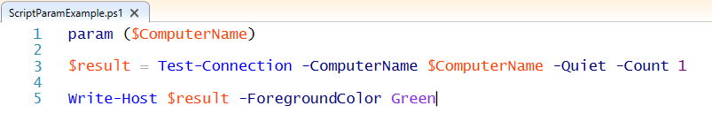
Script Param Statement
Must be first statement in script, except for comments
Parameter values are available to commands in scripts
Param Statement
Parameter
Parameter Value
PS C:\scripts> .\ScriptParamExample.ps1 -ComputerName localhost
True
PS C:\scripts> .\ScriptParamExample.ps1 -ComputerName DoesNotExist
False
PS C:\scripts>

Slide 110
Requires Statement
Special comment
Prevents script from running without required elements
Can only be used in scripts (not functions, cmdlets, etc)
Requires Option | Supported in PS Version
#Requires -Version <N>[.<n>] | 2.0+
#Requires -PSSnapin <PSSnapin-Name> [-Version <N>[.<n>]] | 2.0+
#Requires -ShellId <ShellId> | 2.0+
#Requires -Modules { <Module-Name> | <Hashtable> } | 3.0+
#Requires -RunAsAdministrator | 4.0+
Notes:
get-help about_Requires
TOPIC
about_Requires
SHORT DESCRIPTION
Prevents a script from running without the required elements.
LONG DESCRIPTION
The #Requires statement prevents a script from running unless the Windows
PowerShell version, modules, snap-ins, and module and snap-in version
prerequisites are met. If the prerequisites are not met, Windows PowerShell
does not run the script.
You can use #Requires statements in any script. You cannot use them in
functions, cmdlets, or snap-ins.
SYNTAX
#Requires -Version <N>[.<n>]
#Requires –PSSnapin <PSSnapin-Name> [-Version <N>[.<n>]]
#Requires -Modules { <Module-Name> | <Hashtable> }
#Requires –ShellId <ShellId>
#Requires -RunAsAdministrator
RULES FOR USE
- The #Requires statement must be the first item on a line in a script.
- A script can include more than one #Requires statement.
- The #Requires statements can appear on any line in a script.
PARAMETERS
-Version <N>[.<n>]
Specifies the minimum version of Windows PowerShell that the script
requires. Enter a major version number and optional minor version number.
For example:
#Requires -Version 3.0
-PSSnapin <PSSnapin-Name> [-Version <N>[.<n>]]
Specifies a Windows PowerShell snap-in that the script requires. Enter the snap-in
name and an optional version number.
For example:
#Requires –PSSnapin DiskSnapin -Version 1.2
-Modules <Module-Name> | <Hashtable>
Specifies Windows PowerShell modules that the script requires. Enter the module
name and an optional version number. The Modules parameter is introduced in
Windows PowerShell 3.0.
If the required modules are not in the current session, Windows
PowerShell imports them. If the modules cannot be imported,
Windows PowerShell throws a terminating error.
For each module, type the module name (<String>) or a hash table
with the following keys. The value can be a combination of strings
and hash tables.
-- ModuleName. This key is required.
-- ModuleVersion. This key is required.
-- GUID. This key is optional.
For example,
#Requires -Modules PSWorkflow, @{ModuleName="PSScheduledJob";ModuleVersion=1.0.0.0}
-ShellId
Specifies the shell that the script requires. Enter the shell ID.
For example,
#Requires –ShellId MyLocalShell
-RunAsAdministrator
When this switch parameter is added to your requires statement,
it specifies that the Windows PowerShell session in which you are
running the script must be started with elevated user rights
(Run as Administrator).
For example,
#Requires -RunAsAdministrator
EXAMPLES
The following script has two #Requires statements. If the requirements
specified in both statements are not met, the script does not run.
Each #Requires statement must be the first item on a line:
#Requires –Modules PSWorkflow
#Requires –Version 3
Param
(
[parameter(Mandatory=$true)]
[String[]]
$Path
)
...
NOTES
In Windows PowerShell 3.0, the Windows PowerShell Core packages appear
as modules in sessions started by using the InitialSessionState.CreateDefault2
method, such as sessions started in the Windows PowerShell console. Otherwise,
they appear as snap-ins. The exception is Microsoft.PowerShell.Core, which
is always a snap-in.

Slide 111
Version Requirement
Prevents script from running on lower PowerShell versions
Script errors at start
Avoids unexpected errors from unsupported language, cmdlets, etc.
Special comment tag: #Requires -Version <N>[.<n>]
Get-help About_Requires
Sample Script
#requires -Version 3 Get-ChildItem c:\ -Hidden
Error when script runs within PowerShell v2
.\Test1.ps1 : The script 'Test1.ps1' cannot be run because it contained a "#requires" statement at line 1 for Windows PowerShell version 3.0. The version required by the script does not match the currently running version of Windows PowerShell version 2.0.At line:1 char:12+ .\Test1.ps1 <<<< + CategoryInfo : ResourceUnavailable: (Test1.ps1:String) [], ScriptRequiresException + FullyQualifiedErrorId : ScriptRequiresUnmatchedPSVersion
Notes:
This is a more frequent scenario, the opposite of the one described in the previous section. Imagine we’ve developed some new scripts using PowerShell v3 and its new functionalities. Maybe some of our production machines have not yet been upgraded to PowerShell 2.0. If we tried to run these scripts on these machines, we’d have a serious problem. For example, it makes no sense to run the –Hidden switch in PowerShell 2.0… unless you want to see an ugly red error. If you want to guarantee a minimum PowerShell version, you could check $host.Version inside your script, and act accordingly. However, you can also use the #requires keyword for this purpose. You must use a clause like
#requires –Version 3 at the beginning of the script. If you try to run it on a lower version, it will give out an error, without trying to run the script. To read more, take a look at get-help about_requires

Slide 112
Administrator Requirement
Script requires elevated user rights
Script errors at start indicating
Avoids unexpected errors in script
Special comment tag: #Requires -RunAsAdministrator
Sample Script
#requires -RunAsAdministrator Get-ChildItem c:\ -Hidden
Error when script run from non-elevated session
.\RunAsAdminTest.ps1 : The script 'RunAsAdminTest.ps1' cannot be run because it contains a "#requires" statement for running as Administrator. The current Windows PowerShell session is not running as Administrator. Start Windows PowerShell by using the Run as Administrator option, and then try running the script again. …
Notes:
This is a more frequent scenario, the opposite of the one described in the previous section. Imagine we’ve developed some new scripts using PowerShell v3 and its new functionalities. Maybe some of our production machines have not yet been upgraded to PowerShell 2.0. If we tried to run these scripts on these machines, we’d have a serious problem. For example, it makes no sense to run the –Hidden switch in PowerShell 2.0… unless you want to see an ugly red error. If you want to guarantee a minimum PowerShell version, you could check $host.Version inside your script, and act accordingly. However, you can also use the #requires keyword for this purpose. You must use a clause like
#requires –Version 3 at the beginning of the script. If you try to run it on a lower version, it will give out an error, without trying to run the script. To read more, take a look at get-help about_requires

Slide 113
Demonstration
Param Statement and Requires Statement

Slide 115
Explore Command Precedence Rules

Slide 116
Command Lookup Precedence
PowerShell rules that determine which command to run when there is more than one command with the same name
Note: If the same type of command with the same name exists, PowerShell runs the command that was added to the session most recently
Alias
Function
Cmdlet
External commands
Full Path (e.g. c:\scripts\BigFiles.ps1)

Slide 117
“Replace” Another Command
PS C:\scripts> ping MS
Pinging ms.contoso.local with 32 bytes of data:
Reply from 192.168.1.2: bytes=32 time<1ms TTL=64
Reply from 192.168.1.2: bytes=32 time<1ms TTL=64
Reply from 192.168.1.2: bytes=32 time<1ms TTL=64
Ping statistics for 192.168.1.2:
Packets: Sent = 4, Received = 4, Lost = 0 (0% loss),
Approximate round trip times in milli-seconds:
Minimum = 0ms, Maximum = 0ms, Average = 0ms
PS C:\scripts> New-Alias -Name ping -Value Test-Connection
PS C:\scripts> ping MS
Source Destination IPV4Address IPV6Address
------ ----------- ----------- -----------
WIN10 MS 192.168.1.2
WIN10 MS 192.168.1.2
WIN10 MS 192.168.1.2
Ping now cmdlet instead of external command

Slide 118
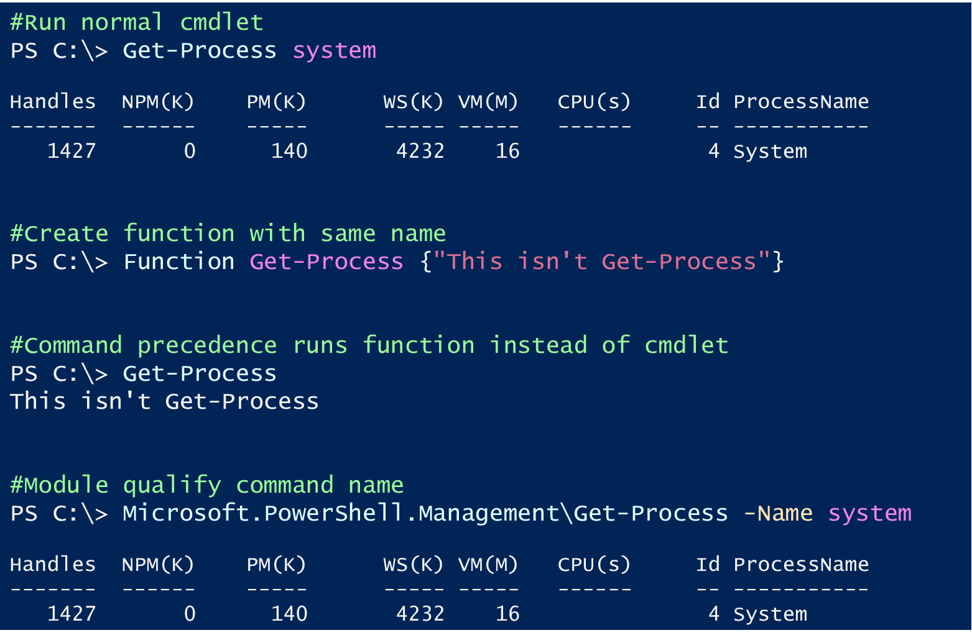
Module Qualify Command Name

Slide 120
Scripts
Notes:
Link to lab: https://labondemand.com/LabProfile/40021

Slide 121
Microsoft

